Slide 1
Leads out of turn !!
Presentation by John McIlrath
ABF National Director Development Officer
April 2017

Slide 2
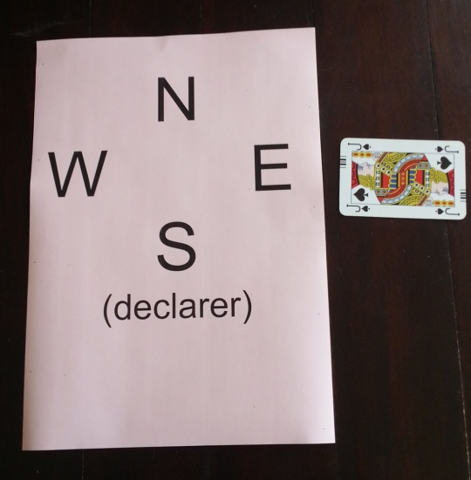
Opening Lead Out Of Turn
South (Declarer) may:-
Accept the lead
Look at Dummy
Be Dummy and let partner play the hand
Not accept lead
Demand a SPADE lead
& card returned to hand
Deny a SPADE lead
& card returned to hand
Allow lead of any other suit & Card lead stay on the table as a MAJOR penalty card and all MAJOR penalty card provisions apply which are …...
N.B. It is UI that E holds that card, if returned to hand

Slide 3
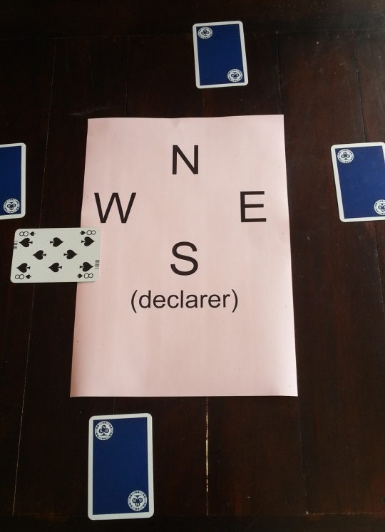
33
Lead Out Of Turn, when declarer (or Dummy) turn
South (Declarer) may:-
Accept the lead
Not accept lead
Card lead stay on the table as a MAJOR penalty card and all MAJOR penalty card provisions apply which are …...
Played at first legal opportunity either:- Leading, Following suit, or Discarding, and if partner gets on lead, declarer will have certain rights as to what can or cannot be lead.

Slide 4
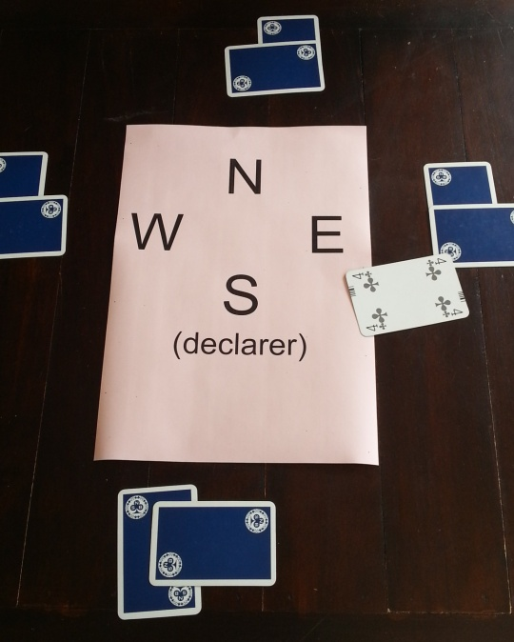
Lead Out Of Turn, when partner won the previous trick
South (Declarer) may:-
Accept the lead
Not accept lead
Demand a CLUB lead
& card returned to hand
Deny a CLUB lead
& card returned to hand
Allow lead of any other suit & Card lead stay on the table as a MAJOR penalty card and all MAJOR penalty card provisions apply which are …...
N.B. It is UI that E holds that card, if returned to the hand.

Slide 5
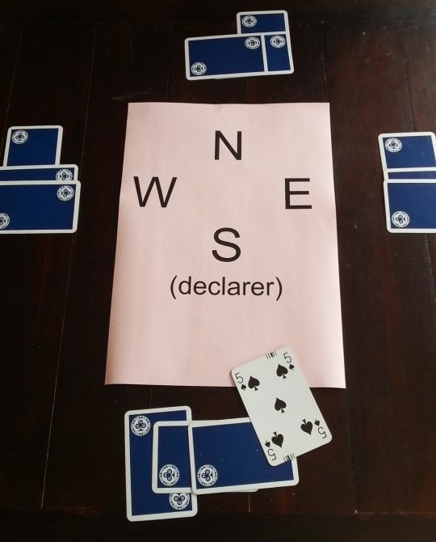
Lead Out Of Turn, by Declarer when opponents won the previous trick
Either defender may accept, or NOT accept the lead.
If they choose differently, then the option expressed by player next in turn shall prevail.
Accept the lead and play continues, as normal
Not accept lead
Card returned to hand
Correct hand leads to trick.
N.B. Declarer can NEVER have a penalty card

Slide 6
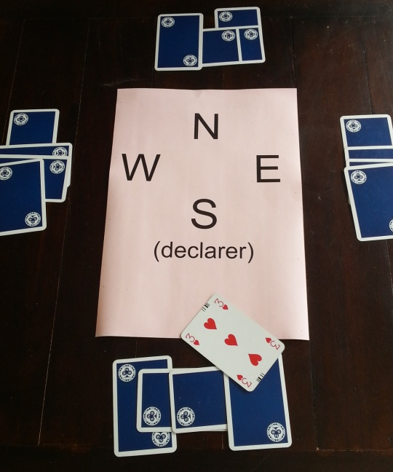
Lead Out Of Turn, by Declarer when DUMMY won the previous trick (or vice-versa)
Either defender may accept, or NOT accept the lead.
If they choose differently, then the option expressed by player next in turn shall prevail.
Accept the lead and play continues, as normal
Not accept lead
Card returned to hand
Correct hand leads to trick.
N.B. A statement that the lead is from the wrong hand is simply drawing attention to the infraction

